Slide 1

Speak fluently
Intermediate

Slide 2
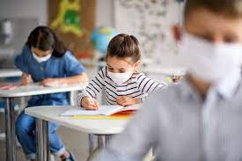

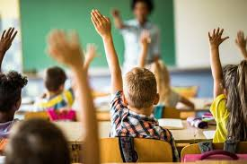
2. Education

Slide 3
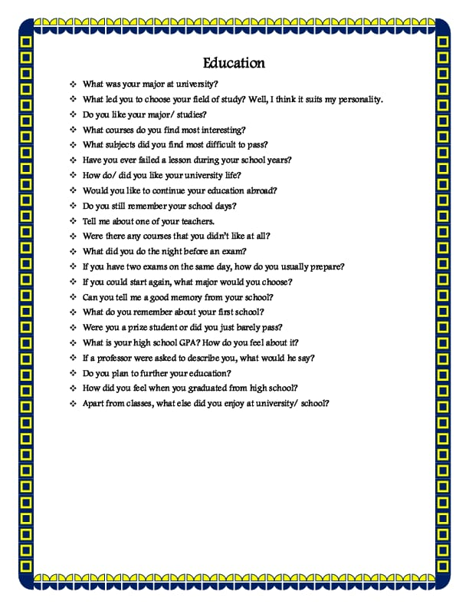
2. Education
Explain the difference between education before and after covid 19.

Slide 4
2. Education
Did you enjoy going to elementary school?
Does your country have middle schools?
What is the age that children begin school where you live?
How old are students they when they graduate?
Did you go to a good high school?
What do you remember about your teachers
Who was your favorite teacher?
What teacher impressed you the most?
Do you still stay in touch with your teachers?
Did you have any teachers you didn't like?
How many students were in your high school?
Describe the students who attended your high school.
Did they have a good influence on you?
Did they make your childhood and teenage years harder or easier?
Did you live in a dormitory while you went to college? Who were your roommates?
What realistic changes would you make to your country's attitude toward education?

Slide 5
2. Education
What made you decide to go to the college you did? Did you work while you were in university?
Where do we learn the skills necessary to become a good student - in elementary, middle or high school or in the university?
What are the skills that separate good students from bad students?
What makes someone qualified to teach children?
Why do students cheat during tests and exams? How do they cheat?
What is your attitude towards cheating? How should parents react? How should teachers react?
What do you consider to be a "smart" or "slow" person?
Do prefer school uniforms or casuals better?
Would you ever want to learn a third language? [To be "trilingual"]
What do you consider "hardworking" or 'lazy"?
Do you think a person can become a genius because of their education, or are they just born that way?
Do you think there were subjects that your school taught and were not important?

Slide 6
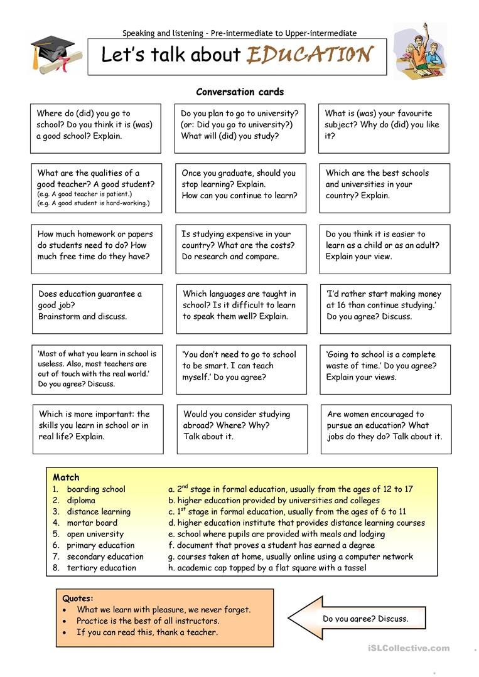
2. Education

Slide 7

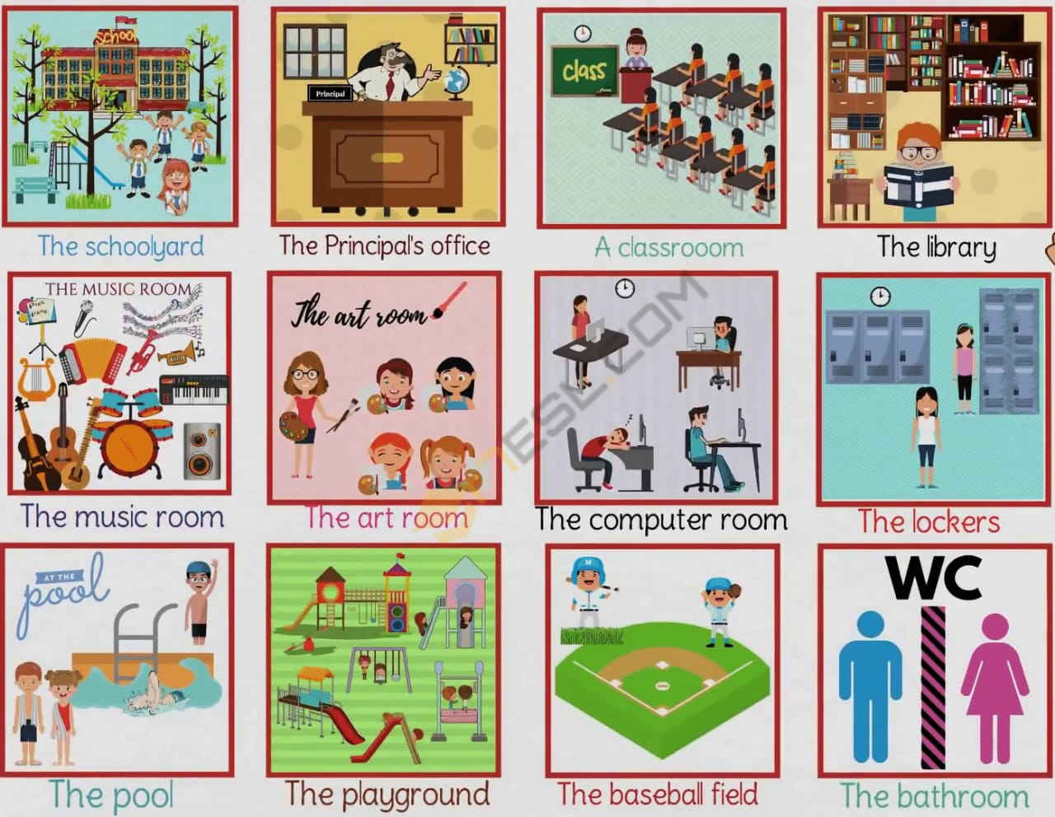
2. Education

Slide 8
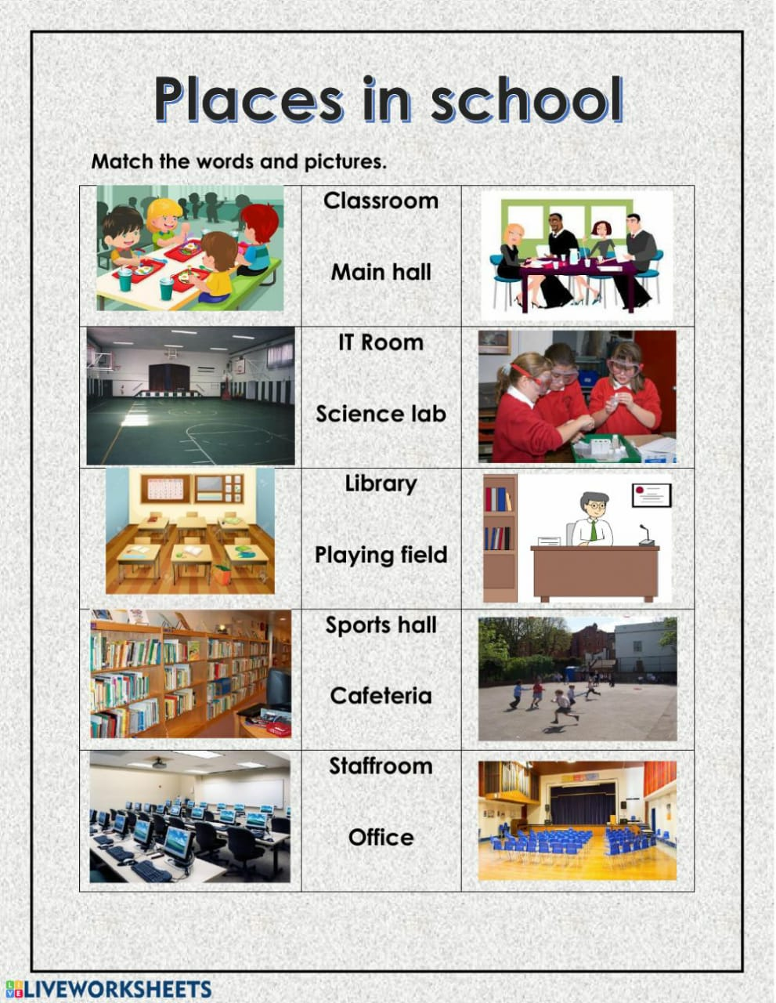
2. Education
English School Vocabulary - New Words And Phrases
mixed emotions – some happy some sad breaking up for – end of term and the start of the holidays to turn to – to start thinking (about) check list – items you need and things you have to do to rummage – to search to discard – to leave to stuff in – to push in faint hope – small chance still fit – still the right size to dump – to throw out to pass down to – to give to sibling – brother or sister a trip to – a journey (to) an assortment of – a mix of new year – new term timetable – schedule of classes to run around – to chase check – yes to catch up with someone – to see someone again to drop (someone) off – to take someone by car to pick up – to start again to get into the groove – to get back into the way of (teaching) to get on with – to return to get down to – to begin

Slide 9
2. Education
Idioms:
A Schoolboy Error
this means a simple error made by someone senior that you would only expect a schoolboy to make
Example:
In the football match, the defender allowed the ball to bounce over his head. The opposition was quick and scored a goal. It was a simple schoolboy error by the defender.
A Teacher’s Pet
someone who is the favorite student of the teacher, always answering first, always doing their homework
Example:
I was hated by most people in my class because I was a real teacher’s pet.
Old-School
usually refers to someone who is a little old fashioned or conservative
Example:
Michael had worked at the bank now for 30 years. He was old-school. His clothes were old fashioned and very conservative.
To Hit The Books
when someone really needs to start studying hard they will use this phrase
Example:
I really need to hit the books this weekend. I have that repeat exam next week.

Slide 10
2. Education
Idioms:
To Make The Grade
when someone is likely or unlikely to be successful in a job or a position we can use this either in the positive or the negative
Example:
I don’t think he will make the grade he is just not suitable for this work.
Or
If he continues to work like this and puts in the effort he will certainly make the grade.
To Teach Someone A Lesson
used when we really wish to punish someone and make sure they know how and why they made the mistake in the hope they will not make it again
Example:
He had failed to complete the customer’s order twice. The boss was really going to teach him a lesson. He made him stay late for 2 days until it was completed. I think he understands now.
Eager Beaver
someone who is very enthusiastic and is willing to work very hard (volunteer, for example)
Example:
Tracey is such an eager beaver, she volunteers for every task. I bet she’s going to get a promotion next year.
With Flying Colours
with ease and with a high mark/grade
Example:
Olivier had been able to concentrate on his studies, and now he passed his exams with flying colours.

